Slide 1

Unboxing Cyber Risk from Theory to Practice
Jiorgos Miskakis, EvidentScientific EMEA CISO

Slide 2

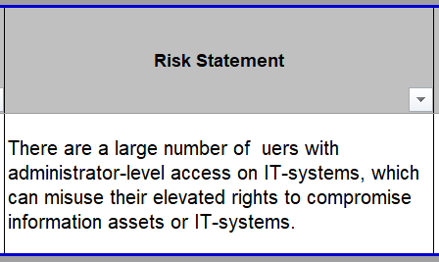
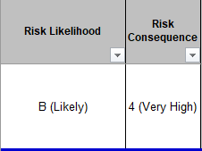
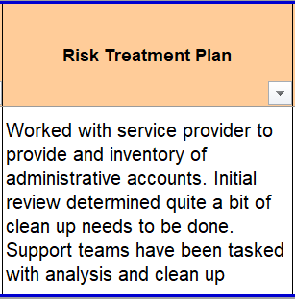
a qualitative risk assessment like:
Subjective scales for likelihood and impact
High level mitigation statements
Difficult boundaries between likely ,most likely, very high …
Generic Treatments

Slide 3



Which leads to:
Explanation needed
Make Questionable
Lengthy ….. Discussions
CISO’s to Quantify fast the risk

Slide 4
What is the highest risk?
Difficulty in Storytelling

Slide 5
Creating a Framework having those Design Principles
Threat-Based Scenarios – Tailor risks to business needs.
Tailor risks to business needs.
Priority
Identify and classify critical assets (triage)
Diversity
Various angles
Flexible attributes
Technology Agnostic
No specific vendor/tech

Slide 6
High Level Process Steps
Build the Scenario
Tailor scenario to business needs.
Impact
Define the controls which reduces it
Likelihood
Define the controls which reduces it
Category
Map scenario to risk category
Triage (asset value)
Framework
Risk Calculation
Risk Decision

Slide 7
Impact is a weighted combination of:
80%
The Asset Value based on the Confidentiality, Integrity and Availability (CIA)
20%
Expected Controls that can reduce impact VS controls that exist.

Slide 8
Likelihood is a weighted combination of:
90%
Technical Controls implemented
5%
Governance controls, e.g Document Policies, implementation guides etc.
Number of privileged users potentially being malicious
5%

Slide 9
How Do We Quantify the Value of an Asset? Weighted CIA
Confidentiality-40%
5-Top Secret, e.g PII, Intellectual Property, blueprints
4-Confidential
Integrity-20%
5-It requires the strictest controls to prevent unauthorized access, modification, or tampering
3-Data at this level is less sensitive and can tolerate a certain degree of modification or inadvertent errors. E.g build process
Availability-40%
5-Max. 2h outage
3-Up to 8h
1-Public
1-Is not relevant, e.g synthetic random data
1-Can remain down till someone will decide otherwise
4-Max. 4h outage
2-Up to 12h

Slide 10
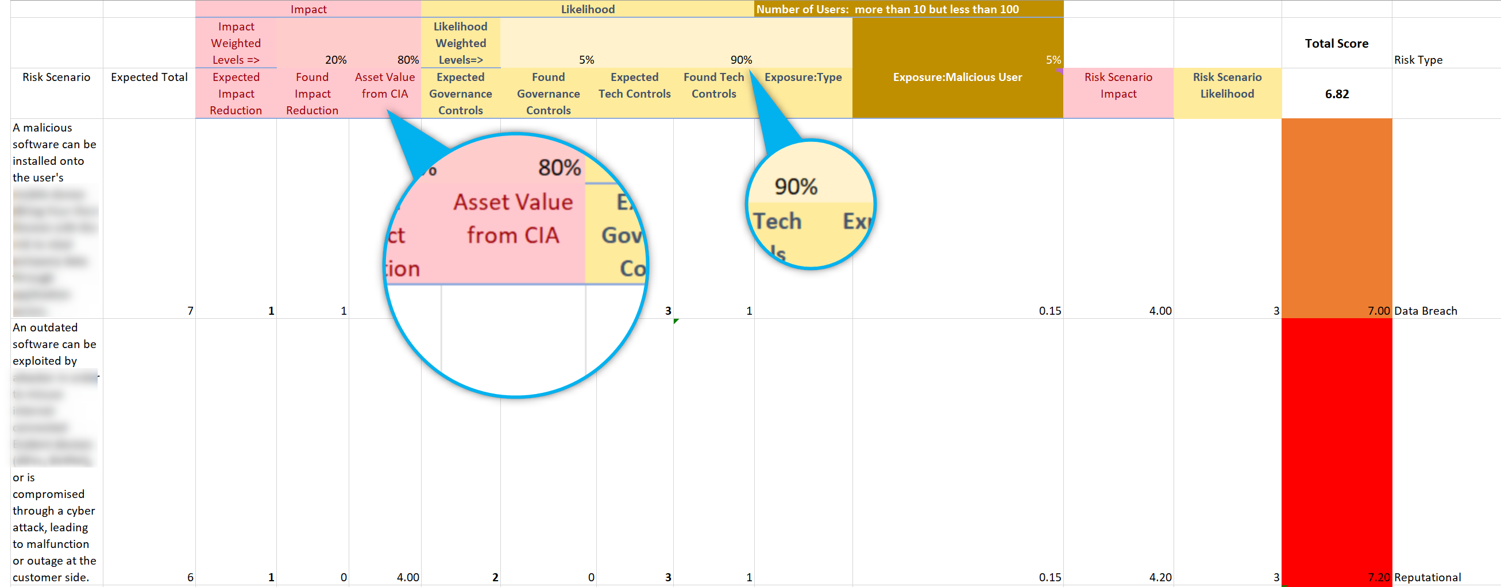
How it looks like

Slide 11
Key Takeaways
Simplifies interactions with intuitive, accessible questions
Provides Clarity
Provides Auditability
Storytelling
Time Considerations
Complexity Is Hidden
Tech Agnostic
Risk categories

Slide 12
Key Takeaways
Scenario creation is time consuming and needs feedback from multiple stakeholders
Storytelling
Time Considerations
Complexity Is Hidden
Tech Agnostic
Risk categories

Slide 13
Key Takeaways
Providing the enduser an easy to understand story
Controls statements, or mapping to various Security frameworks can be done in background
Storytelling
Time Considerations
Complexity Is Hidden
Tech Agnostic
Risk categories

Slide 14
Key Takeaways
Can be applied from spreadsheets to web UI’s and it is not tighten to a specific product or vendor
Storytelling
Time Considerations
Complexity Is Hidden
Tech Agnostic
Risk categories

Slide 15
Key Takeaways
Risks can be categorized, enabling better aggregation ,analysis and integration to Enterprise Risk Management (ERM).
Storytelling
Time Considerations
Complexity Is Hidden
Tech Agnostic
Risk categories

Slide 16


SCAN or Click for demo
Thank you!
Jiorgos Miskakis
https://www.linkedin.com/in/miskakis/
ISACA CISM,CISA,CDPSE,CRISC,
PECB ISO27K Auditor&Implementer,
ITIL v3

